Slide 1

Quantum Computing
2101041: MD Rohan Mondal
2101042: MD Naimur Rashid

Slide 2
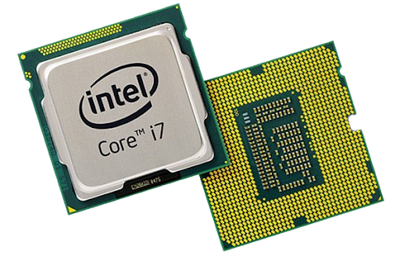
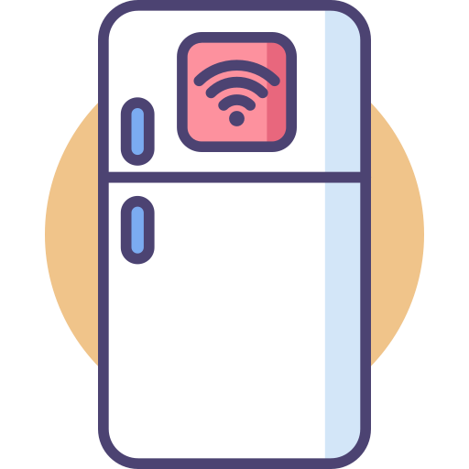

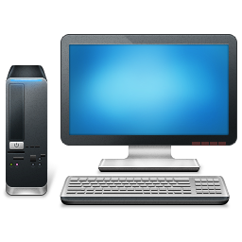



Introduction
Quantum Computing
Ragular Computers : Regular computers use bits, which are either ones or zeros, to process information. These bits are passed through logic gates, like AND, OR, NOT, and XOR, that manipulate the data and produce the desired output. These gates are made using transistors and are based on the properties of silicon semiconductors.
Main unit – CPU (Central processing unit)
Brain of Computers

Slide 3
Introduction
Quantum Computing
Inside the CPU
Ragular Computers : Regular computers use bits, which are either ones or zeros, to process information. These bits are passed through logic gates, like AND, OR, NOT, and XOR, that manipulate the data and produce the desired output. These gates are made using transistors and are based on the properties of silicon semiconductors.
Main unit – CPU (Central processing unit)
Brain of Computers
The CPU is built on a silicon wafer, which serves as the foundation for creating incredibly small circuits. These circuits are responsible for processing all logical operations, enabling the CPU to execute instructions and perform computations efficiently.

Slide 4

Introduction
Quantum Computing
What is Quantum Computing?
Inside the CPU
The CPU is built on a silicon wafer, which serves as the foundation for creating incredibly small circuits. These circuits are responsible for processing all logical operations, enabling the CPU to execute instructions and perform computations efficiently.
Main unit – CPU (Central processing unit)
Brain of Computers

Slide 5
Introduction
Quantum Computing
What is Quantum Computing?
Quantum computing operates at the atomic and subatomic level, leveraging the principles of quantum mechanics to perform computations. It utilizes quantum phenomena like superposition and entanglement to process information in ways that traditional computers cannot achieve.
The CPU is built on a silicon wafer, which serves as the foundation for creating incredibly small circuits. These circuits are responsible for processing all logical operations, enabling the CPU to execute instructions and perform computations efficiently.

Slide 6

Introduction
Quantum Computing
What is Quantum Computing?
Quantum computing operates at the atomic and subatomic level, leveraging the principles of quantum mechanics to perform computations. It utilizes quantum phenomena like superposition and entanglement to process information in ways that traditional computers cannot achieve.
About 100 Years ago, A new stream of physics appeared in front of the world. Its name is Quantum Mechanics.

Slide 7

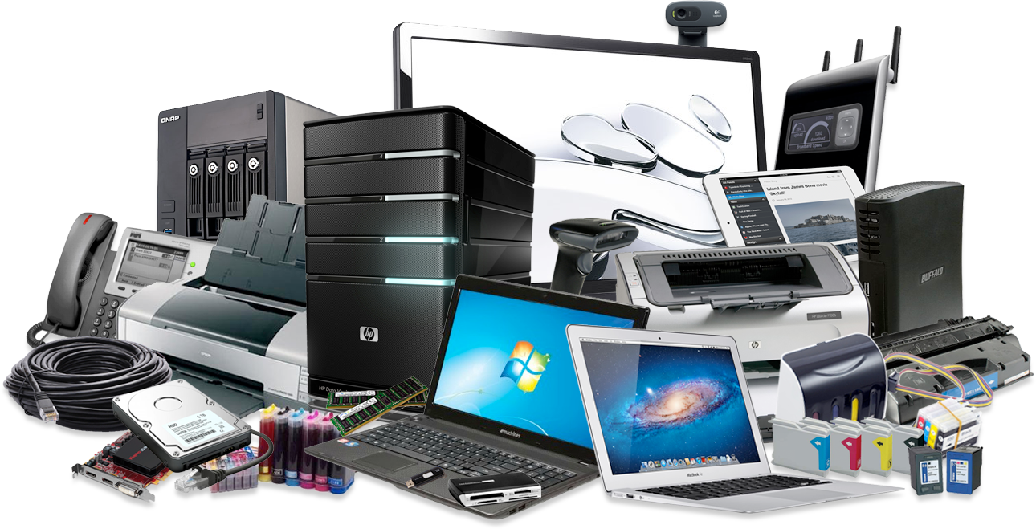
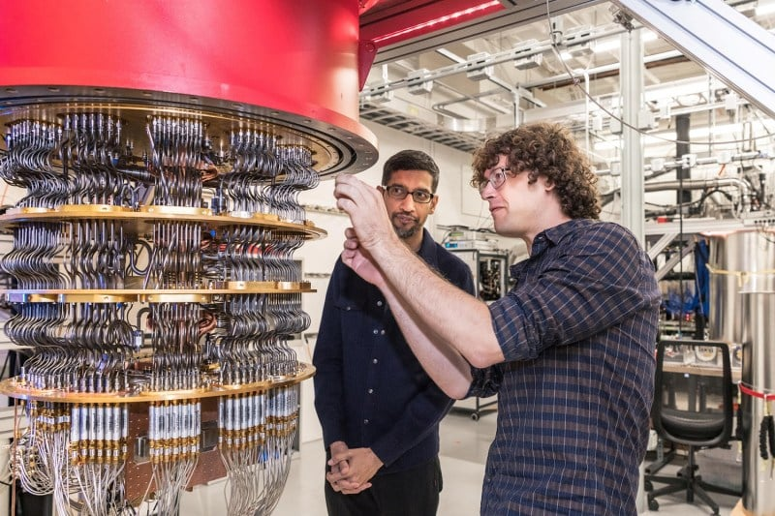
Introduction
Quantum Computing
About 100 Years ago, A new stream of physics appeared in front of the world and its name is Quantum Mechanics.
About 40 years ago, some physicists came up with the idea that we can make some different types of computers with the help of quantum mechanics.
They said that some of these some of these Such things can be done which our most powerful classical computers will never be able to do it.
Quantum computing operates at the atomic and subatomic level, leveraging the principles of quantum mechanics to perform computations. It utilizes quantum phenomena like superposition and entanglement to process information in ways that traditional computers cannot achieve.

Slide 8
Introduction
Quantum Computing
About 100 Years ago, A new stream of physics appeared in front of the world and its name is Quantum Mechanics.
About 40 years ago, some physicists came up with the idea that we can make some different types of computers with the help of quantum mechanics.
They said that some of these some of these Such things can be done which our most powerful classical computers will never be able to do it.

Slide 9
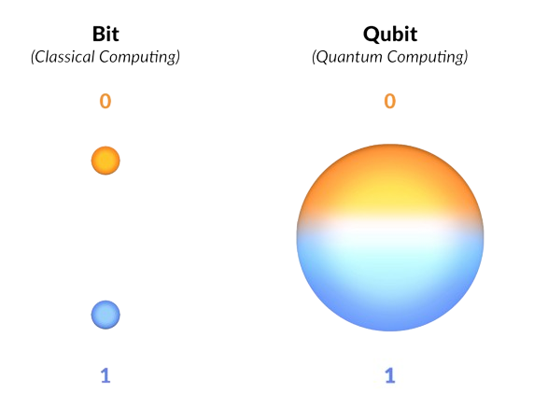
Introduction
Classical vs. Quantum Mechanics
Key Concepts
Quantum Computing
Quantum Mechanics
It deals with microscopic particles
It is based on the Schrödinger equation
In Planck’s postulation, only discrete values of energy are emitted or absorbed – origin of “quantum”
Because of Heisenberg’s uncertainty principle and de Broglie hypothesis dual nature of matter (both particle & wave), the state of a system cannot be specified exactly
It gives probabilities of finding particles at various locations in space
Classical Mechanics
It deals with macroscopic particles
It is based on Newton’s laws of motion and Maxwell’s electromagnetic wave theory.
Any amount of energy may be emitted or absorbed continuously
The state of a system is defined exactly by specifying their positions and velocities
The future state can be predicted with certainty
About 100 Years ago, A new stream of physics appeared in front of the world and its name is Quantum Mechanics.
About 40 years ago, some physicists came up with the idea that we can make some different types of computers with the help of quantum mechanics.
They said that some of these some of these Such things can be done which our most powerful classical computers will never be able to do it.
quantum computers use a unit called a qubit to process information. A qubit is similar to a bit, but it has unique quantum properties such as superposition and entanglement. This means that a qubit can exist in both the one and zero states at the same time.

Slide 10
Introduction
Key Concepts
Classical vs. Quantum Mechanics
Quantum Computing
Quantum Mechanics
It deals with microscopic particles
It is based on the Schrödinger equation
Because of Heisenberg’s uncertainty principle and de Broglie hypothesis dual nature of matter (both particle & wave), the state of a system cannot be specified exactly
It gives probabilities of finding particles at various locations in space
Classical Mechanics
It deals with macroscopic particles
It is based on Newton’s laws of motion and Maxwell’s electromagnetic wave theory.
Any amount of energy may be emitted or absorbed continuously
The state of a system is defined exactly by specifying their positions and velocities
The future state can be predicted with certainty
About 100 Years ago, A new stream of physics appeared in front of the world and its name is Quantum Mechanics.
About 40 years ago, some physicists came up with the idea that we can make some different types of computers with the help of quantum mechanics.
They said that some of these some of these Such things can be done which our most powerful classical computers will never be able to do it.
quantum computers use a unit called a qubit to process information. A qubit is similar to a bit, but it has unique quantum properties such as superposition and entanglement. This means that a qubit can exist in both the one and zero states at the same time.

Slide 11
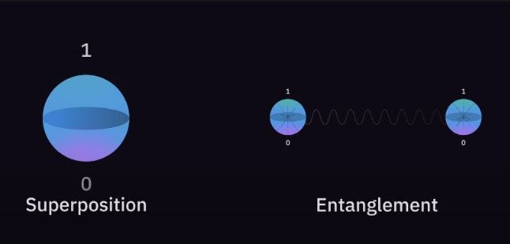
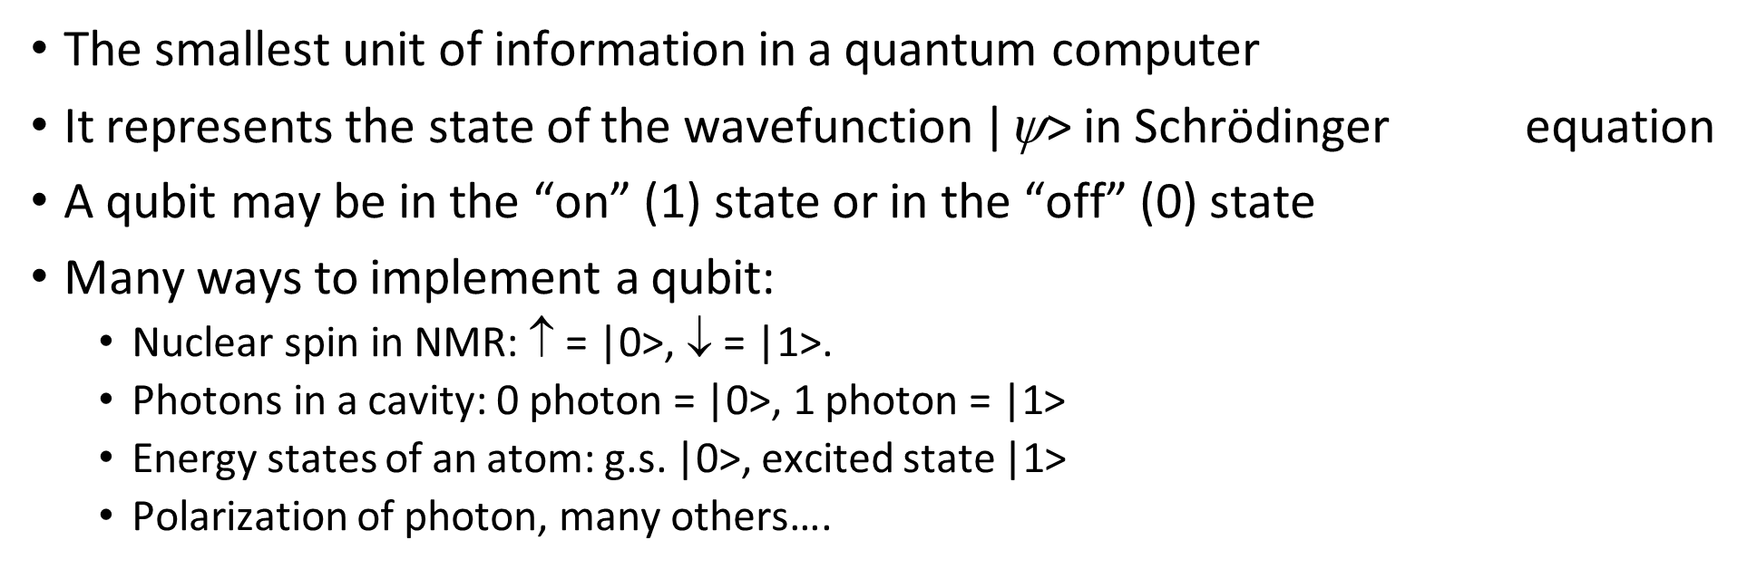
Introduction
Quantum Bit - Qubit
Quantum Computing
Key Concepts
Superposition: A classical bit is limited to being either 0 or 1 at any moment. A qubit, in contrast, can exist in a superposition of both 0 and 1 at the same time, increasing the computational possibilities. This means that a quantum computer can process many calculations in parallel, making it far more powerful for certain tasks.
quantum computers use a unit called a qubit to process information. A qubit is similar to a bit, but it has unique quantum properties such as superposition and entanglement. This means that a qubit can exist in both the one and zero states at the same time.
About 100 Years ago, A new stream of physics appeared in front of the world and its name is Quantum Mechanics.
About 40 years ago, some physicists came up with the idea that we can make some different types of computers with the help of quantum mechanics.
They said that some of these some of these Such things can be done which our most powerful classical computers will never be able to do it.

Slide 12
Introduction
Key Concepts
Quantum Bit - Qubit
Quantum Computing
Superposition: A classical bit is limited to being either 0 or 1 at any moment. A qubit, in contrast, can exist in a superposition of both 0 and 1 at the same time, increasing the computational possibilities. This means that a quantum computer can process many calculations in parallel, making it far more powerful for certain tasks.
About 100 Years ago, A new stream of physics appeared in front of the world and its name is Quantum Mechanics.
About 40 years ago, some physicists came up with the idea that we can make some different types of computers with the help of quantum mechanics.
They said that some of these some of these Such things can be done which our most powerful classical computers will never be able to do it.
quantum computers use a unit called a qubit to process information. A qubit is similar to a bit, but it has unique quantum properties such as superposition and entanglement. This means that a qubit can exist in both the one and zero states at the same time.

Slide 13
Introduction
Quantum Computing
Qbits
Superposition: A classical bit is limited to being either 0 or 1 at any moment. A qubit, in contrast, can exist in a superposition of both 0 and 1 at the same time, increasing the computational possibilities. This means that a quantum computer can process many calculations in parallel, making it far more powerful for certain tasks.
Entanglement:
When a pair or group of particles is generated, interact, or share spatial proximity in a way such that the quantum state of each particle of the pair or group cannot be described independently of the state of the others, even when the particles are separated by a large distance.
An entangled pair is a single quantum system in a superposition of equally possible states. The entangled state contains no information about the individual particles, only that they are in opposite states.
If the state of one is changed, the state of the other is instantly adjusted to be consistent with quantum mechanical rules.
If a measurement is made on one, the other will automatically collapse.
Quantum entanglement is at the heart of the disparity between classical and quantum physics: entanglement is a primary feature of quantum mechanics lacking in classical mechanics.
Entanglement is a joint characteristic of two or more quantum particles.
Einstein called it “spooky actions at a distance”
quantum computers use a unit called a qubit to process information. A qubit is similar to a bit, but it has unique quantum properties such as superposition and entanglement. This means that a qubit can exist in both the one and zero states at the same time.

Slide 14
Quantum Computing
Qbits
Entanglement:
When a pair or group of particles is generated, interact, or share spatial proximity in a way such that the quantum state of each particle of the pair or group cannot be described independently of the state of the others, even when the particles are separated by a large distance.
An entangled pair is a single quantum system in a superposition of equally possible states. The entangled state contains no information about the individual particles, only that they are in opposite states.
If the state of one is changed, the state of the other is instantly adjusted to be consistent with quantum mechanical rules.
If a measurement is made on one, the other will automatically collapse.
Quantum entanglement is at the heart of the disparity between classical and quantum physics: entanglement is a primary feature of quantum mechanics lacking in classical mechanics.
Entanglement is a joint characteristic of two or more quantum particles.
Einstein called it “spooky actions at a distance”
Superposition: A classical bit is limited to being either 0 or 1 at any moment. A qubit, in contrast, can exist in a superposition of both 0 and 1 at the same time, increasing the computational possibilities. This means that a quantum computer can process many calculations in parallel, making it far more powerful for certain tasks.
quantum computers use a unit called a qubit to process information. A qubit is similar to a bit, but it has unique quantum properties such as superposition and entanglement. This means that a qubit can exist in both the one and zero states at the same time.

Slide 15
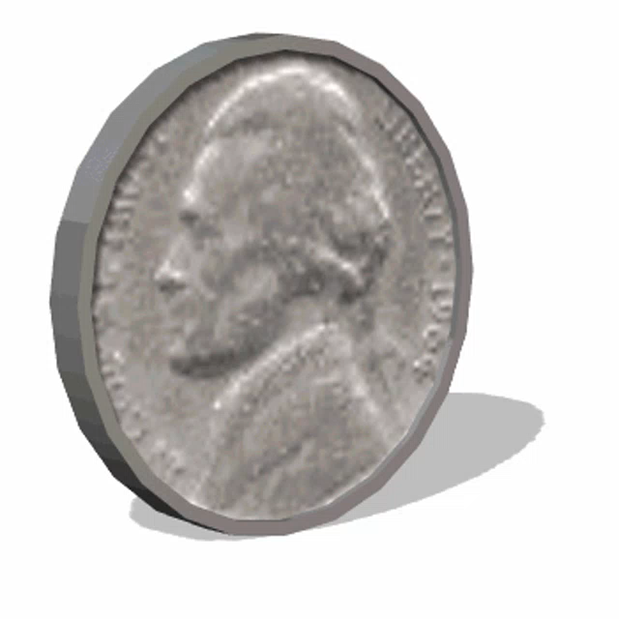
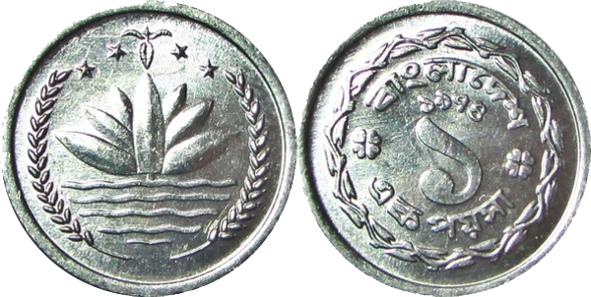
Bit and Qbit
Quantum Computing
Bit
0
1
0
1
Super position

Slide 16
Classical bit vs Qbit
Quantum Computing
0
Bit
1
0
1
Super position
CLASSICAL BITS:
can be in two distinct states, 0 and 1
can be measured completely
are not changed by measurement
can be copied
can be erased
QUANTUM BITS:
can be in state |0> or in state |1> or in any other state that is a linear combination of the two states
can be measured partially with given probability are changed by measurement
cannot be copied
cannot be erased

Slide 17
How Qbits works
Quantum Computing

Slide 18
How Qbits works
Quantum Computing
2 Qbits:
00 01 10 11
000 001 010 011
100 101 110 111

Slide 19
How Qbits works
Quantum Computing
3 Qbits:
000 001 010 011
100 101 110 111
00 01 10 11

Slide 20
How Qbits works
Quantum Computing
n Qbits:
2^{n}
000 001 010 011
100 101 110 111
00 01 10 11

Slide 21
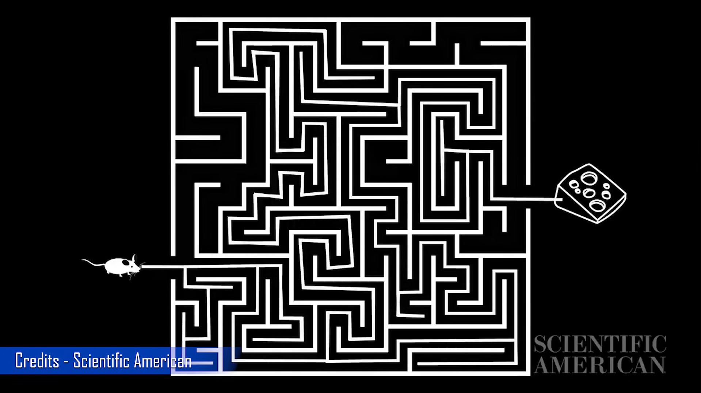
Quantum Computing
Maze check by classical computer:

Slide 22
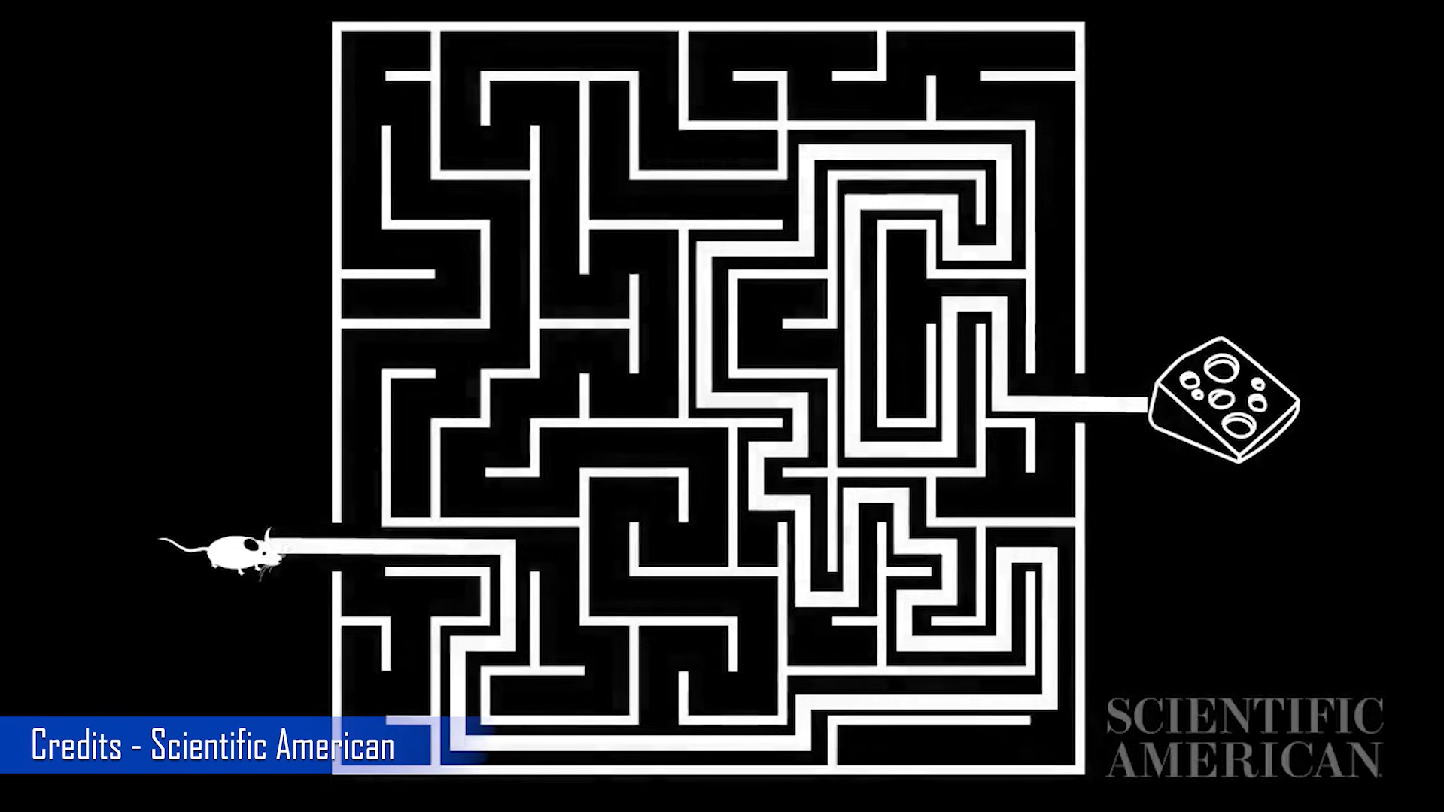
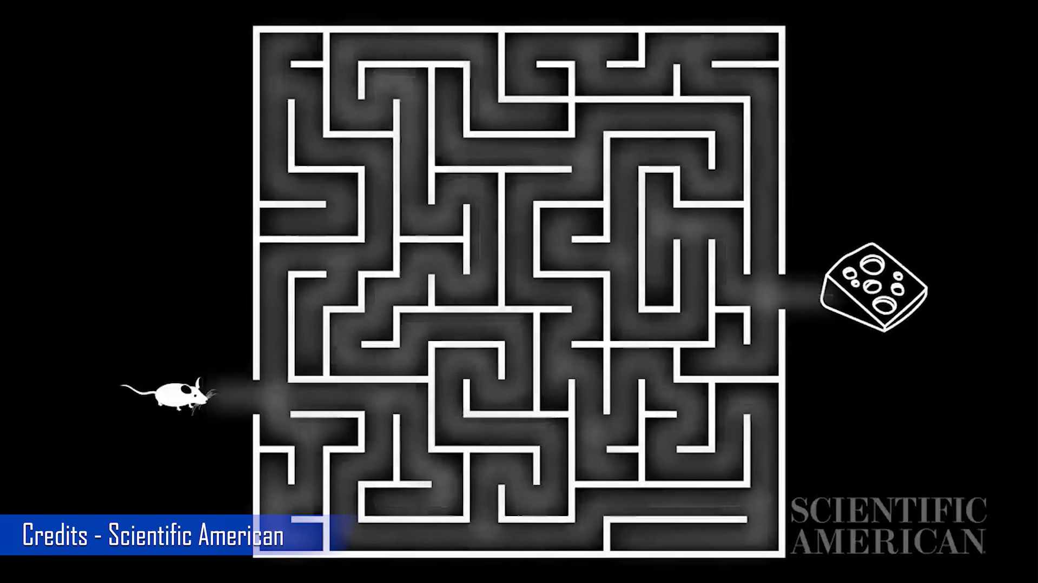
Quantum Computing
Maze check by Quantum computer:

Slide 23
Quantum Computing
Maze check by Quantum computer:

Slide 24
Quantum Computing

Slide 25

Quantum Computing Race - Corporations
R&D investments reach $10.7 billion by 2024

Slide 26
Advantages of Qubits & Enormous Quantum Power
Adding qubits increases storage exponentially
Quantum computer doubles the power with every added qubit
To double the power of a digital computer 32bits -> 64 bits
To double the power of a quantum computer 32qubits -> 33 qubits
Can do operations on all superpositions…like massively parallel computation
One math operation on 2^{n} numbers encoded in classical computers with n bits requires 2^{n} steps or parallel processors, but the same operation on 2^{n} numbers encoded by n qubits takes 1 step
A 64-bit computer can perform manipulation on 64-bit binary numbers at a time.
A 64-qubit quantum computer operates in a space of 2⁶⁴ dimensions, or roughly 16,000,000,000,000,000,000 (16*10¹⁸) numbers to specify the state of the quantum system.
This makes complex problems much easier to solve by quantum computer

Slide 27
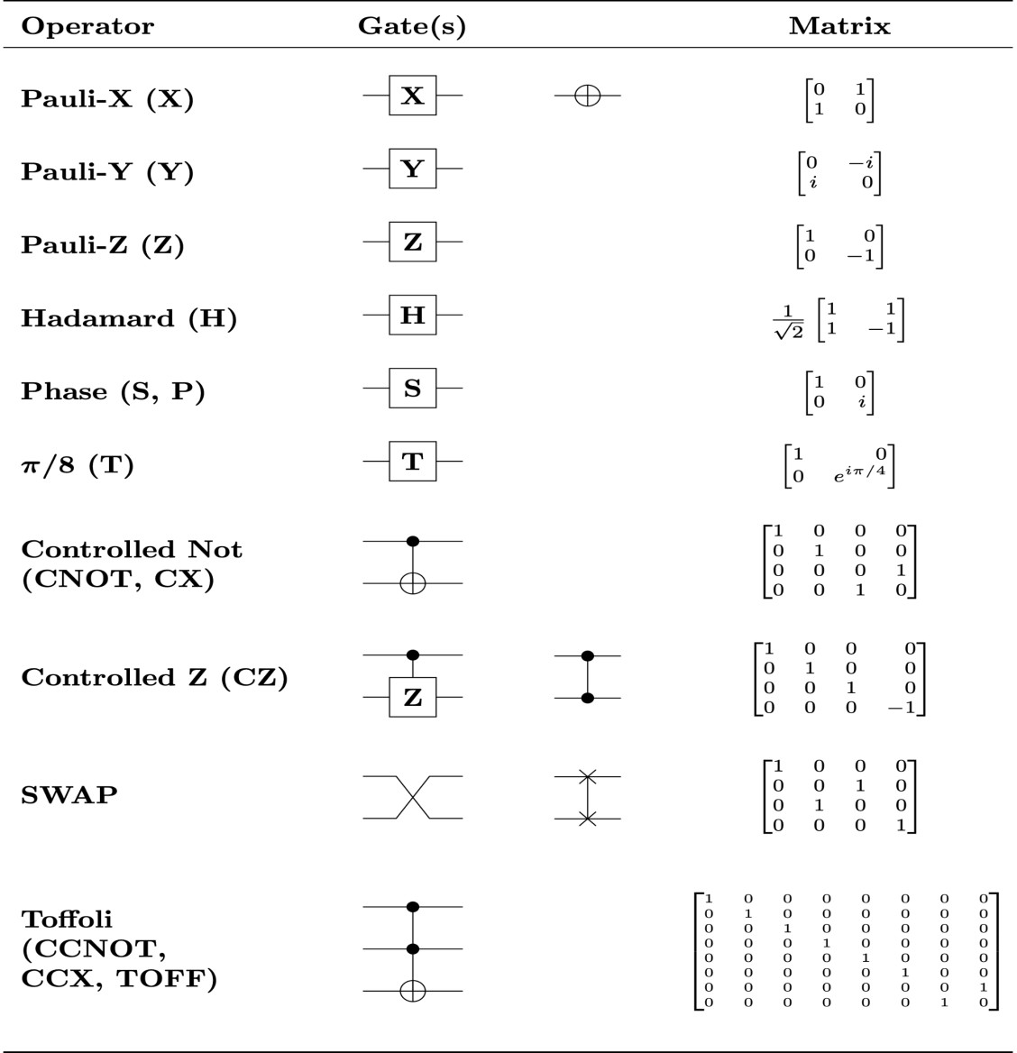

Quantum vs. Classic Gates
x | y
0 | 1
1 | 0
x | y | z
0 | 0 | 0
0 | 1 | 0
1 | 0 | 0
1 | 1 | 1
x | y | z
0 | 0 | 1
0 | 1 | 1
NOT gate
x
y = NOT(x)
AND gate
x
y
z = (x) AND (y)
NAND gate
x
y
z = (x) NAND (y)
1 0
1
 |  |  |  | 1 |  | 1 |  | 0
 |  |  |  | x |  | y |  | z
 |  |  |  | 0 |  | 0 |  | 0
 |  | z = (x) OR (y) |  | 0 |  | 1 |  | 1
 |  |  |  | 1 |  | 0 |  | 1
 |  |  |  | 1 |  | 1 |  | 1
 |  |  |  | x |  | y |  | z
 |  |  |  | 0 |  | 0 |  | 1
 |  | z = (x) NOR (y) |  | 0 |  | 1 |  | 0
 |  |  |  | 1 |  | 0 |  | 0
 |  |  |  | 1 |  | 1 |  | 0
 |  |  |  | x |  | y |  | z
 |  |  |  | 0 |  | 0 |  | 0
 |  | z = (x) XOR (y) |  | 0 |  | 1 |  | 1
 |  |  |  | 1 |  | 0 |  | 1
OR gate
x
y
NOR gate
x
y
XOR gate
x
y

Slide 28






















Quantum vs. Classical Circuits
Classical Logic Circuits
Circuit behavior is governed implicitly by classical physics
Signal states are simple bit vectors, e.g. X
= 01010111
Operations are defined by Boolean
Algebra
No restrictions exist on copying or measuring signals
Small well-defined sets of universal gate
types, e.g. {NAND},
{AND,OR,NOT}, {AND,NOT}, etc.
Well developed CAD methodologies exist
Circuits are easily implemented in fast, scalable and macroscopic technologies such as CMOS
^{c}n–1 a₀
s₀
b₀
s₁
a₁
b₁
s
2
a₂
b
2
s₃
a₃
Sum
b
3
c_{n}
Carry

Slide 29
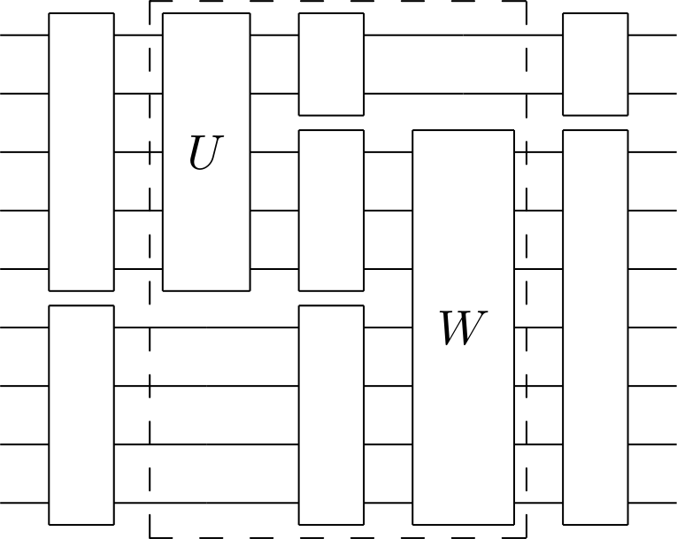
Quantum vs. Classical Circuits
Quantum Logic Circuits
Circuit behavior is governed explicitly by quantum
mechanics
Signal states are vectors interpreted as a superposition of binary “qubit” vectors with complex- number coefficients
2^{n} −1
^{Ψ =} ∑ ^{c}i ^{i}n −1^{i}n−1^{…i}0
i = 0
Operations are defined by linear algebra over Hilbert Space and can be represented by unitary matrices with complex elements
Severe restrictions exist on copying and measuring
signals
Many universal gate sets exist but the best types are not obvious
Circuits must use microscopic technologies that are slow, fragile, and not yet scalable, e.g., NMR

Slide 30
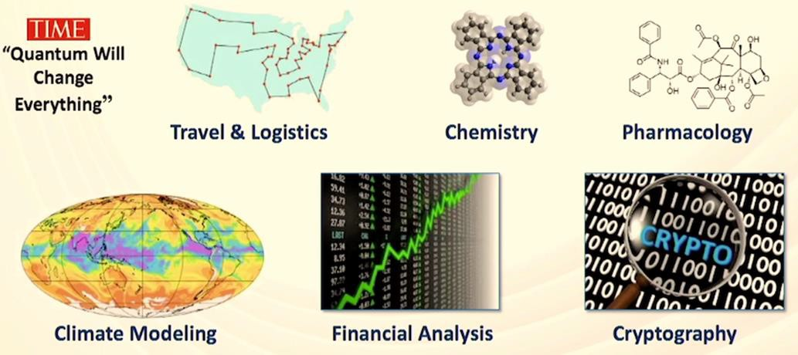
Applications of Quantum Computers

Slide 31
Application 1. Quantum Factoring
A quantum computer can factor numbers exponentially faster than classical computers
15 = 3 × 5 (…easy)
38647884621009387621432325631 = ? × ?
Best classical algorithm: 10²⁴ steps | Shor’s quantum algorithm: 10¹⁰ steps
On classical THz computer: 150,000 years | On quantum THz computer: <1 second
Importance: cryptanalysis
public key cryptography relies on inability to factor large numbers
Application 2: Quantum Search
L. Grover (1997)
A quantum computer can find a marked entry in an unsorted database quadratically faster than classical computers
Importance: “satisfiability” problems
fast searching of big data
inverting complex functions
determining the median or other global properties of data
pattern recognition; machine vision
(e.g., given a phone number, finding the owner’s
name in a phonebook)

Slide 32
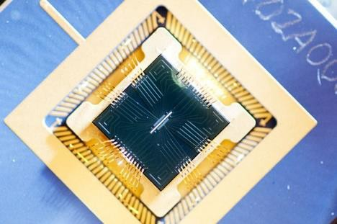
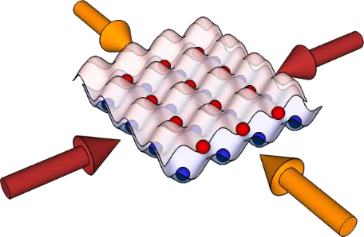
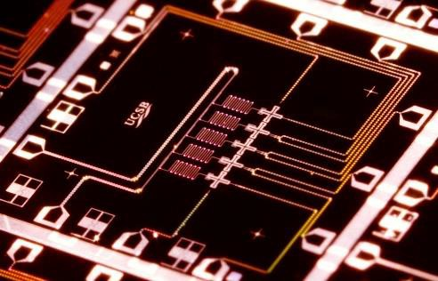
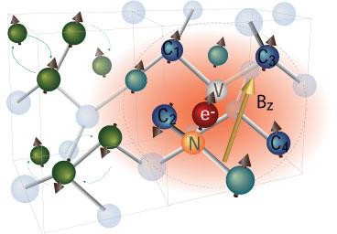
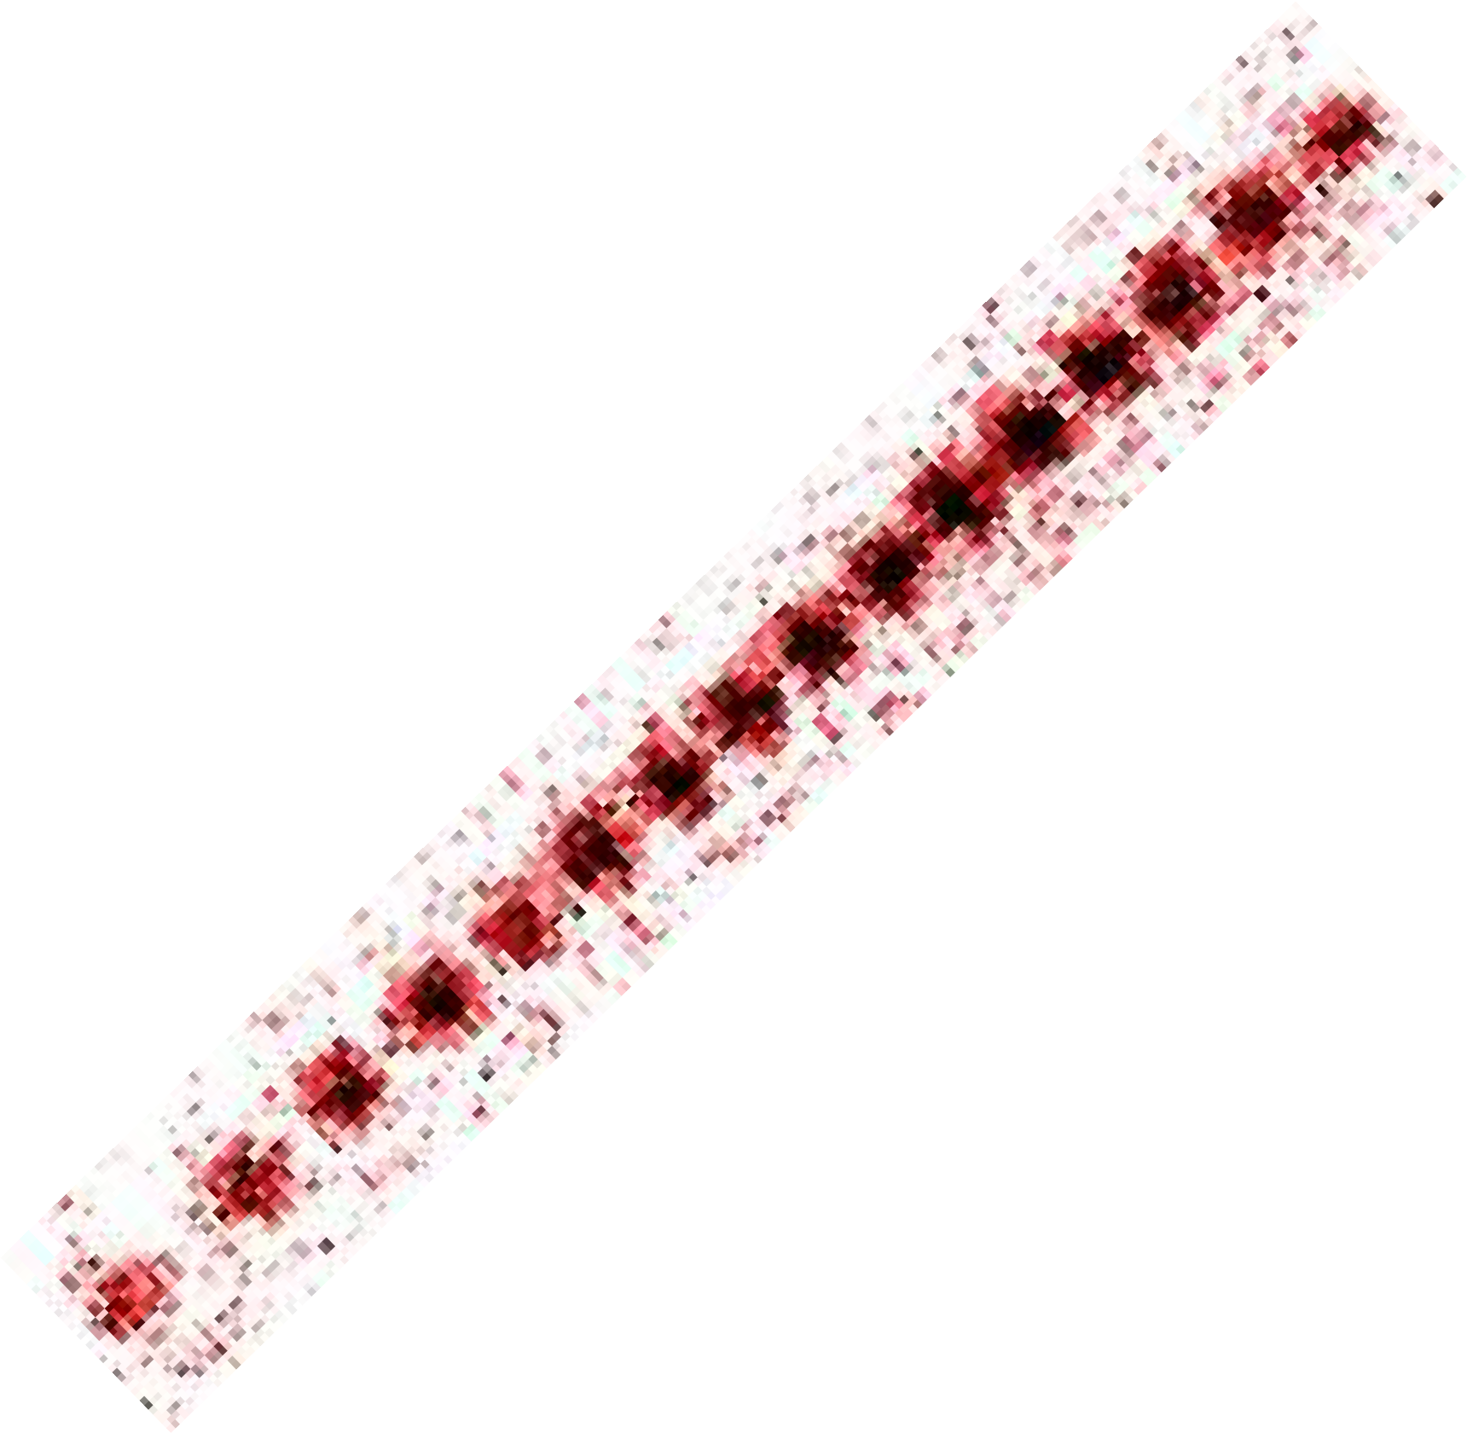

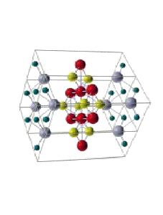
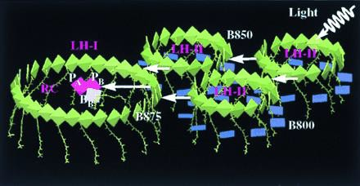
Application 3: Quantum Simulation
Quantum modelling is hard: N quantum systems require
solution to 2^{N} coupled eqns
𝜕Ψ
𝑖ℏ = 𝐻Ψ
𝜕𝑡
Alternative approach: Implement model of interacting system on a quantum simulator, or “standard” set of
qubits with programmable interactions
Atomic ions
Trapped atoms Superconductors
NV-diamond
Quantum Material Design Understand exotic material properties or design new quantum materials from the bottom up
Energy and Light Harvesting Use quantum simulator to program QCD lattice gauge theories, test ideas connecting cosmology to information theory (AdS- CFT etc..)
Quantum Field Theories Program QCD lattice gauge theories, test ideas connecting cosmology to information theory (AdS-CFT etc..)
high-T_{C}
super- conductor

Slide 33
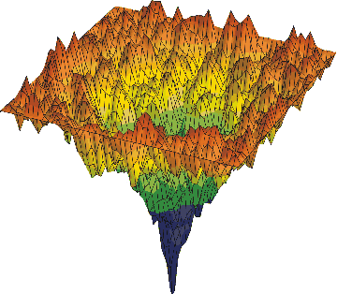
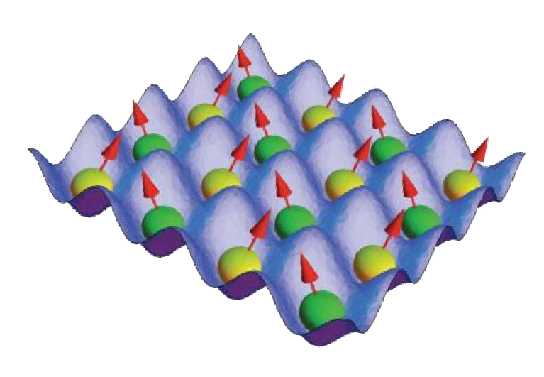
Application 4: Quantum Optimization
x₂
Minimizing complex (nonlinear) functions by “simultaneously sampling” entire space through quantum superposition
Relevant to
Logistics
Operations Research
VLSI design
Finance
x₁
global minimum
of f (x₁,x₂ )
Example: quadratic optimization
Minimize
𝑓(𝑥₁, 𝑥₂, … ) = ෍ 𝑞_{𝑖𝑗} 𝑥_{𝑖}𝑥_{𝑗} + ෍ 𝑐_{𝑖} 𝑥_{𝑖}
𝑖<𝑗
this function maps to energy of
quantum magnetic network
Killer Application?
could crack a large class of intractable
problems: factoring, “traveling salesman”
problem, etc..
BUT not known if there is always a quantum speedup
𝑖

Slide 34
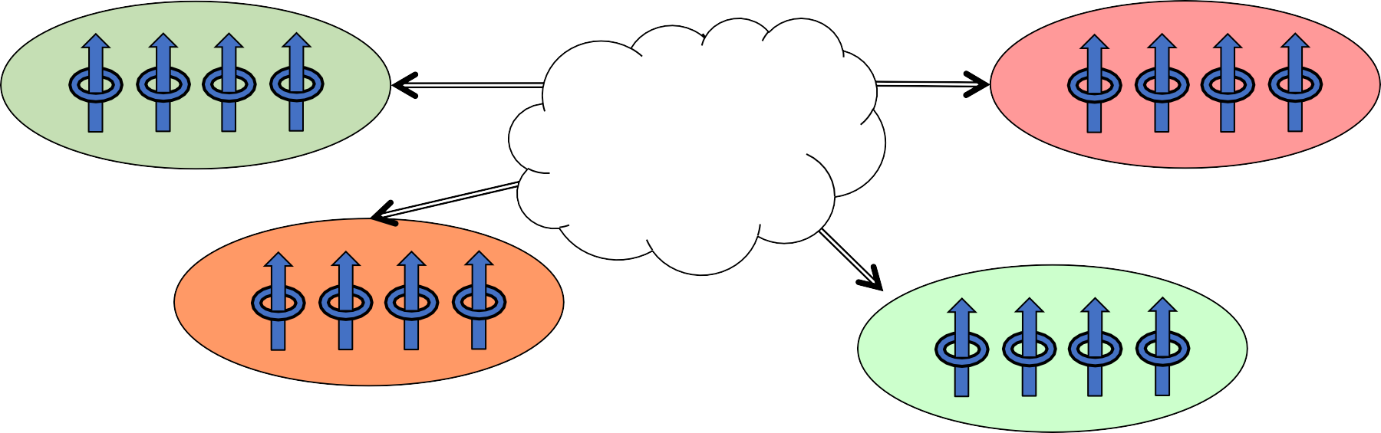
Application 5: Quantum Networks
Location A
Distance L
Location B
(0.1m – 10,000km)
Quantum Network
Location C
Location D
Uses of a quantum network
Secret key generation: cryptography
Certifiable random number generation
Quantum repeaters (“amplifiers”)
Distributed quantum entanglement for optimal decision making
Large-scale quantum computing

Slide 35
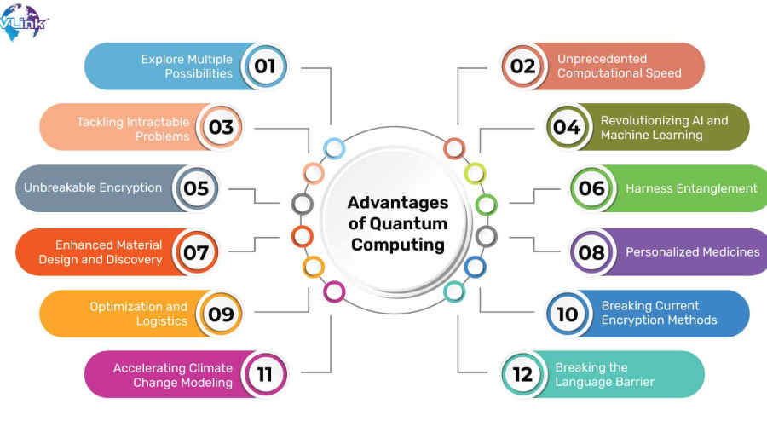
Advantages of Quantum Computing
1. Exponential Speedup
2. Complex Problem Solving
3. Parallelism and Superposition
4. Superposition:
5.Quantum Entanglement.
6.AI and Machine Learning Efficiency

Slide 36
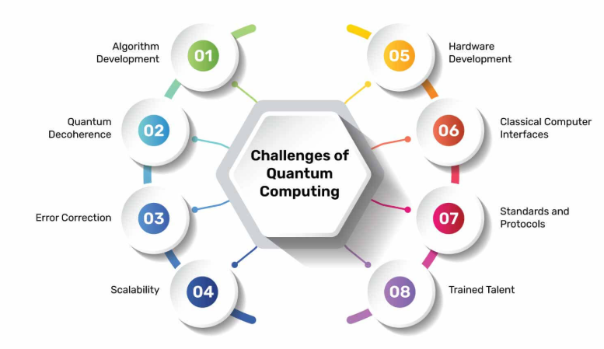
Challenges and Limitations of Quantum Computing
Error Rates and Noise in Qubits
Qubits are sensitive to external disturbances.
Quantum coherence is difficult to maintain.
High error rates reduce reliability of calculations.
Temperature
absolute zero (around -273°C or 0 Kelvin)
Scalability Issues
Building large quantum computers requires stable qubit architecture.
Increasing qubits without increasing errors is a significant engineering challenge.
Need for Quantum Error Correction
Classical error correction methods are inadequate.
New quantum error-correcting codes are needed to preserve quantum information.

Slide 37
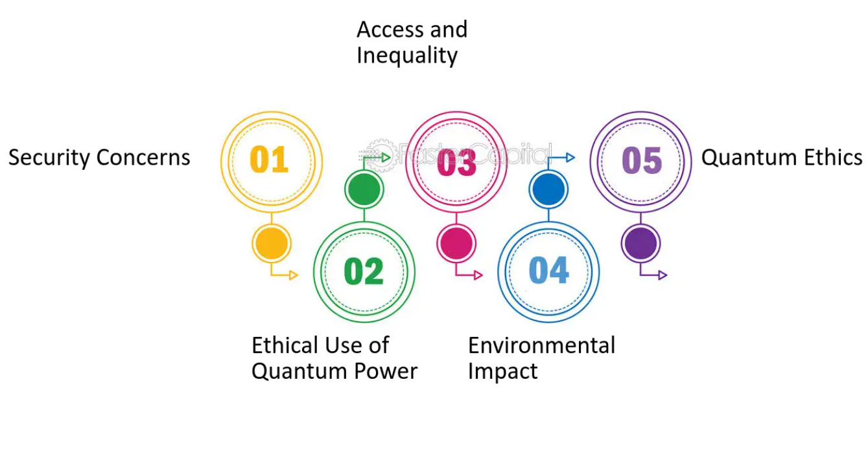
Ethical and Security Risks
Risks to Current Cryptographic
Systems:
Quantum computers could break widely-used cryptographic algorithms (RSA, ECC).
Urgency to develop post-quantum cryptography.
Balancing Innovation with Privacy Concerns:
Safeguarding sensitive data in the quantum era.
Ethical concerns over access to quantum computing power.
Potential misuse in surveillance, hacking, or military applications.

Slide 38
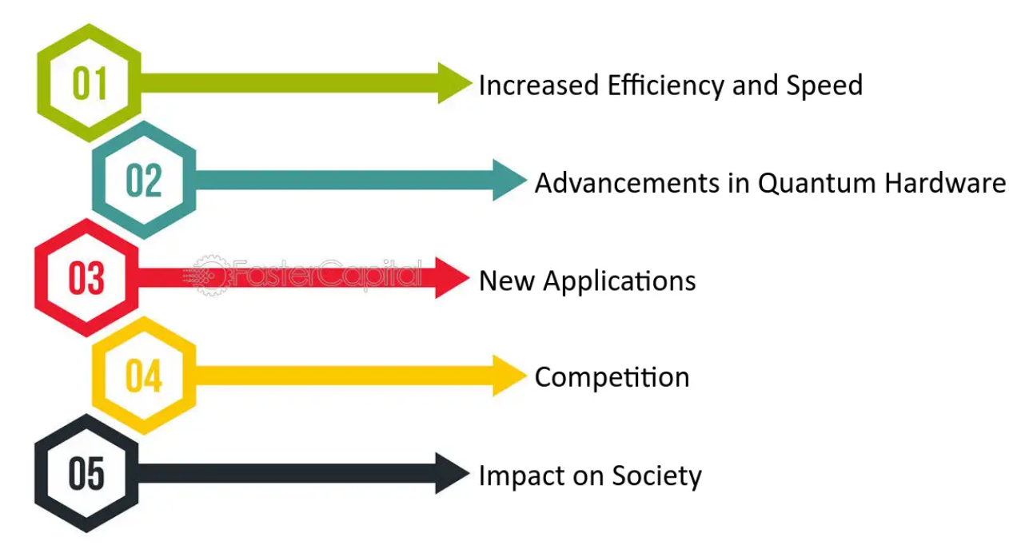
Future Prospects of Quantum Computing
Potential Industry Impact
Pharmaceuticals: Accelerated drug discovery through molecular simulations.
Finance: Optimizing complex financial models.
Energy: Advancing materials science for more efficient energy storage.
AI and Machine Learning: Enhancing computational power for advanced algorithms.
Societal Impact
Revolutionize computing capabilities.
New opportunities in solving currently unsolvable problems.
Creation of new industries and job markets.

Slide 39
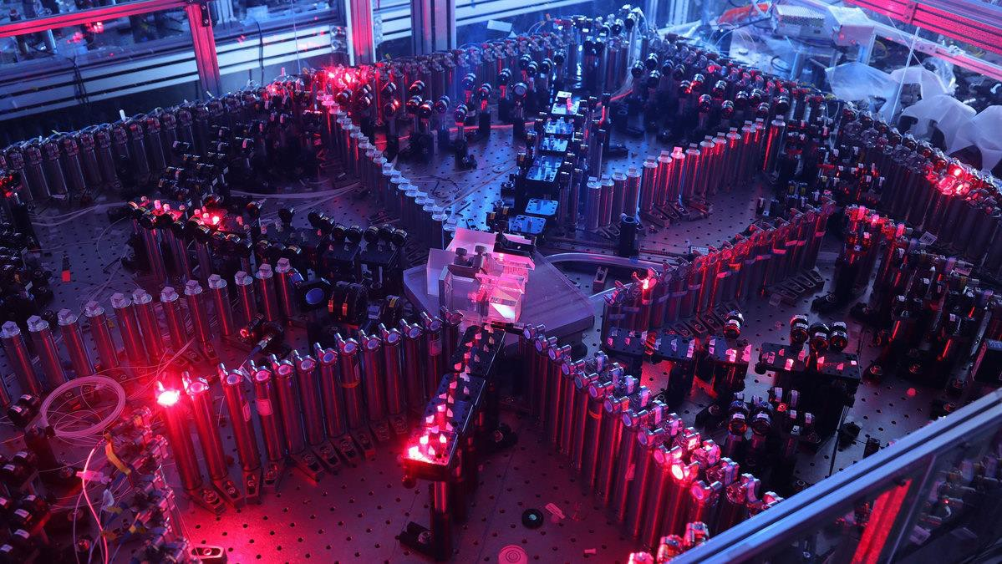
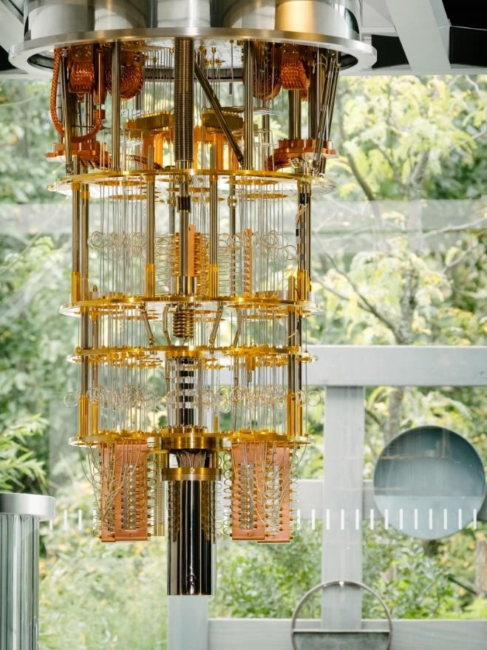
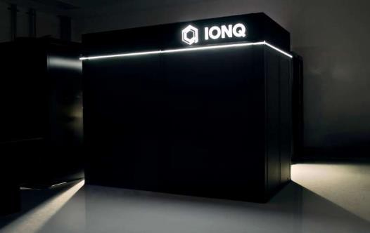
What does a quantum computer look like?
Chinese 76-qubit photon-based quantum computer
IonQ, ion-trap-based 32-qubit quantum computer
IBM 53-qubit superconductor-based quantum compute₁r₆

Slide 40
Thank You

